Slide 1
AQS webinar
Welcome.
Webinar starts at 2 pm Eastern.
There is no phone line. You will need a speaker on your PC to hear this webinar.
February 2013

Slide 2
Agenda
Welcome/Housekeeping
Recent Changes
Planned Enhancements
Data Integrity Issues
User Support Issues
Questions and Answers

Slide 3
Who should attend today?
People who submit data to AQS
People who use QA data from AQS
People who are in the data certification chain

Slide 4
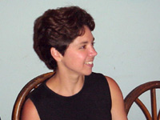
Who is presenting?
Presenter: Robert Coats (AQS Team lead)
US EPA, National Air Data Group
MC: Nick Mangus
US EPA, National Air Data Group
Questions: Angie Shatas
US EPA, National Air Data Group

Slide 5
Housekeeping – Using GotoWebinar
GotoWebinar
Use the Question area to submit questions
Do not raise your hand; just submit a question
Please do not use Chat area to ask a question
Audio
VOIP-only (no conference line)
If you cannot hear us
Make sure your speakers are not muted
Call GotoWebinar support at 800 263 6317
We will mute all attendees to minimize noise
Q& A session at end

Slide 6
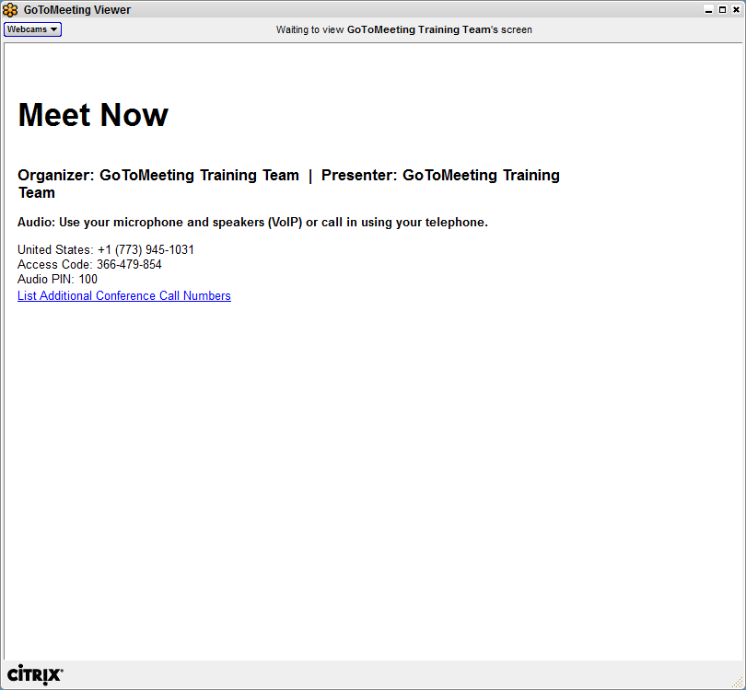
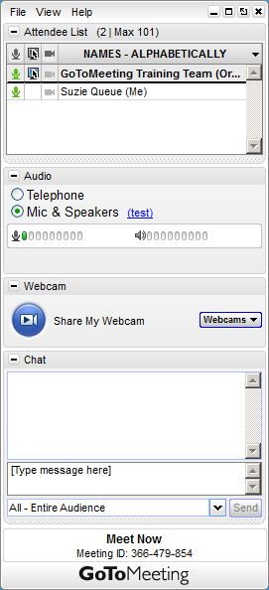
Your GoToMeeting interface
Notes:
Notes:
The GoToMeeting attendee interface is made up of two parts. The Viewer Window is where attendees see the presenter’s screen. The Viewer Window can be resized by clicking and dragging the lower right corner. The Control Panel is where attendees can interact with organizers.

Slide 7
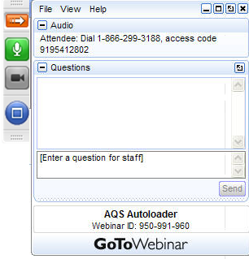
Attendee Control Panel
Expand & collapse your Panel
Questions during the Webinar? Type in your question here and Send
Notes:
Notes:
This slide provides instructions on entering the Audio Pin for telephone attendees. If your attendee has not yet entered their Audio Pin, they must enter “#[the number]#” to their telephone keypad to identify their line and enable individual muting control through GoToMeeting.
Notes on slide performance: Click 1 – Highlights Audio pane
Click 2 – Highlights Audio Pin
Click 3 – Updates Attendee panel to show the Audio Pin was accepted and attendee is successfully connected to audio

Slide 8
Question/Answer Session
Now taking questions – use the Question area on the Control Panel
We will review and answer questions at the end of the webinar
Remember, all attendees are muted. Use the Question area!
Answers will be given over the phone
Today’s materials and a recording of the webinar will be posted to the AQS website.
Thank you for joining today!

Slide 9
Purpose of Webinars
AQS conferences are:
Hard (expensive) to get to
Infrequent (we’re not having one in 2013)
We’re going to use regular webinars to communicate information about AQS
Hopefully we’ll get more participation than conferences
We can provide more frequent updates than once every year or two
Each webinar will be given twice
Same webinar repeated at a different time to accommodate schedules
Currently, we’re thinking of the webinar being quarterly
We can keep it short
Updates plus chance to track longer projects

Slide 10
Recent Changes
ENSC Enhancements (User note - 1/31/2013)
ENSC automatically zips the file for you
Includes file name with each Transaction ID in status screen
ENSC automatic retries to send file; better status info
PQAO Access to Raw Data via Batch (User note - 12/14/2012)
Raw Data can be entered online & “Save” sends it to Production status (User note - 10/19/2012)
Output automatically generated Precision Data (Criteria Pollutants) (User note - 12/12/2012)
Disable all report formats except PDF. Workfiles still work! (coming soon)

Slide 11
Planned Enhancement Data Certification
What?
New certification process.
Why?
So certification will better reflect Part 58.15
When?
April 2013 (i.e. to certify 2012 data!)
Updated procedures will be forthcoming
Next AQS webinar will be devoted to certification (April)
Prerequisite: Disambiguate Monitor Agency Role:
“Reporting Agency”→ ”Monitoring Agency”
EPA will bulk change, then you modify (if necessary)

Slide 12
Planned Enhancement Data Certification
New Certification Report
Submit with certification letter
Use in place of AMP450 and AMP255
Will show a “Recommended Certification (‘Y’/’N’) based on QA statistics and completeness
New AQS Certification Form/Screen
Allow Monitoring Agencies to pick specific monitor-years to certify

Slide 13
Planned Enhancement New PM NAAQS
Published: Jan. 15, 2013
Effective: Mar. 18, 2013
http://www.gpo.gov/fdsys/pkg/FR-2013-01-15/pdf/2012-30946.pdf
Scheduled AQS Changes: (User note - 12/14/2012)
New AQI Breakpoints: March 18, 2013
New Annual Standard Level: March 18, 2013
Discontinue Seasonal 98th Percentile: June 2013
Updated Design Value validity tests: June 2013

Slide 14
Planned Enhancement New QA Processing
What?
New QA Transactions (one per Assessment Type)
New Reports (updated AMP255 and “Raw” report)
Why?
New QA/QC Assessments (for NATTS program and non-criteria pollutants)
Fully support Part 58 Appendix A
Ambiguous fields on P&A transactions
When can you start using? Summer 2013
When must you start using? 2015
In 2015, all QA transactions must be in the new format.

Slide 15
Planned Enhancement Monitor-Method
What?
Store Method at the monitor for a date-range
New input transaction and Maintain Monitor tab
Raw data will be validated against Monitor-Method (AQS will support method on RD, but if it doesn’t match what is at monitor-level, then will result in a LOAD error)
Why?
Part 58 specifies that monitors implement a method
PM 10 guidance - data for different methods should not be combined
Most frequent question we can’t answer: “What method does this monitor use?”
Database Performance: Storing method for Raw Data rather than monitors is the largest single performance problem
When? Later this year.

Slide 16
Planned Enhancement Multiple files per Zip
What?
AQS and the ENSC will allow multiple files to be included in the same Zip file
Currently only one file per submitted Zip archive is allowed
Why?
In response to your user requests
Plan: AQS will process each file independently
When? Summer 2013

Slide 17
Planned Enhancement Agency Access Control
What? Realign access to updating data
Why? To better reflect real-world situations and give agencies access to contractor-loaded data
“Screening Groups” own monitors; only users assigned to the screening group can submit or maintain monitor data
Causes a problem if multiple agencies need to access monitor data
Plan: Use Monitor Agency Roles to control access
Roles: PQAO, Monitoring (Reporting), Analyzing, Collecting, and new role, “Submitting”
When? With QA Project (summer 2013)

Slide 18
Data Integrity Issues
Please do not (ever) submit PM 2.5 or Lead data from a collocated monitor under the primary monitor POC
Never, ever, ever
When filter samples are analyzed by a lab (e.g. for lead), the monitor agency role, “Analyzing” should be populated with the agency code of the lab.

Slide 19
A Few Last Words
Next webinar in April 2013 is on certification
No AQS Basics classes are scheduled
Request through your Regional Office
Your RO contacts are on the AQS website
Other outreach? Tribal Q&A is bi-monthly
EPA is getting new email system on Feb 18
Don’t be surprised if you don’t hear from us for a bit
Who to call with AQS questions?
EPA Helpdesk at 866-411-4372
Level 1 for routine password resets
Level 2 for AQS-specific help - ask for “AQS support”

Slide 20
Question/Answer Session
Now taking questions – use the Question area on the Control Panel. Remember, all attendees are muted.
Answers will be given over the phone
May not have time for all
Today’s materials and a recording of the webinar will be posted to the AQS website
You will see an exit survey as you leave this webinar. We appreciate your feedback!
Thank you for joining today!

