Slide 1
Response to Workshop Recommendations for Adding NH₃ Measurements at CASTNET sites

Slide 2
Ammonia Monitoring
Recommendation from the workshop:
Add NH3 measurements to current CASTNET sites
NADP has deployed denuders at 2 sites (OK99 and IL11) to compare to the Radiello® passive samplers
EPA’s ORD, CAMD and OAQPS have deployed URG annular denuders and MetOne Super SASS denuders at five CASTNET/AMoN sites for additional quality assurance
EPA and NPS are committed to supporting ammonia measurements at CASTNET sites to meet one of the strongest recommendations from the CASTNET workshop

Slide 3
AMoN
NADP’s passive ammonia monitoring network (AMoN) has deployed passive samplers at over 20 sites in the Midwest region
AMoN was accepted as an NADP sub-network at the Fall Scientic Symposium in October 2010
Radiello® samplers were chosen for the network due to their consistently high precision and accuracy when compared to the URG annular denuders

Slide 4
Accuracy
 | RPD | ARPD
N | 36 | 36
Max | 55% | 119%
P90 | 10% | 70%
P75 | -4% | 56%
P50 | -32% | 37%
P25 | -56% | 15%
P10 | -70% | 3%
Min | -119% | 0%
Relative percent difference (RPD) and absolute relative percent difference (ARPD) between
denuder NH3 concentration and triplicate Radiello concentration. Measurements are from
IL11 (Bondville) and OK99 (Cherokee Nation).

Slide 5
Accuracy

Slide 6
Precision
SITEID | AVG | CV | N
CO13 | 3.51 | 6.29 | 187
ID03 | 1.04 | 2.78 | 18
IL11 | 1.27 | 12.26 | 204
IN99 | 1.31 | 8.05 | 188
KS24 | 4.82 | 5.71 | 186
MI96 | 1.56 | 6.43 | 179
MN18 | 0.32 | 15.56 | 185
MN29 | 5.06 | 13.07 | 77
MN42 | 1.15 | 8.8 | 79
NC06 | 1.2 | 14.34 | 23
NC30 | 0.39 | 9.68 | 116
NC35 | 4.21 | 5.42 | 74
NC99 | 0.42 | 10.07 | 27
NM98 | 0.41 | 12.75 | 170
NM99 | 1.05 | 6.79 | 179
NY16 | 0.52 | 6.85 | 62
NY67 | 0.36 | 17.07 | 204
OH02 | 0.64 | 7.84 | 191
OH27 | 1.43 | 10.51 | 184
OK99 | 1.16 | 7.05 | 188
ON07 | 1.07 | 9.72 | 202
PA00 | 1.46 | 6.58 | 66
SC05 | 0.28 | 14.5 | 197
TX43 | 3.07 | 6.44 | 203
WI07 | 1.84 | 6.69 | 184
AVG | 1.58 | 9.25

Slide 7
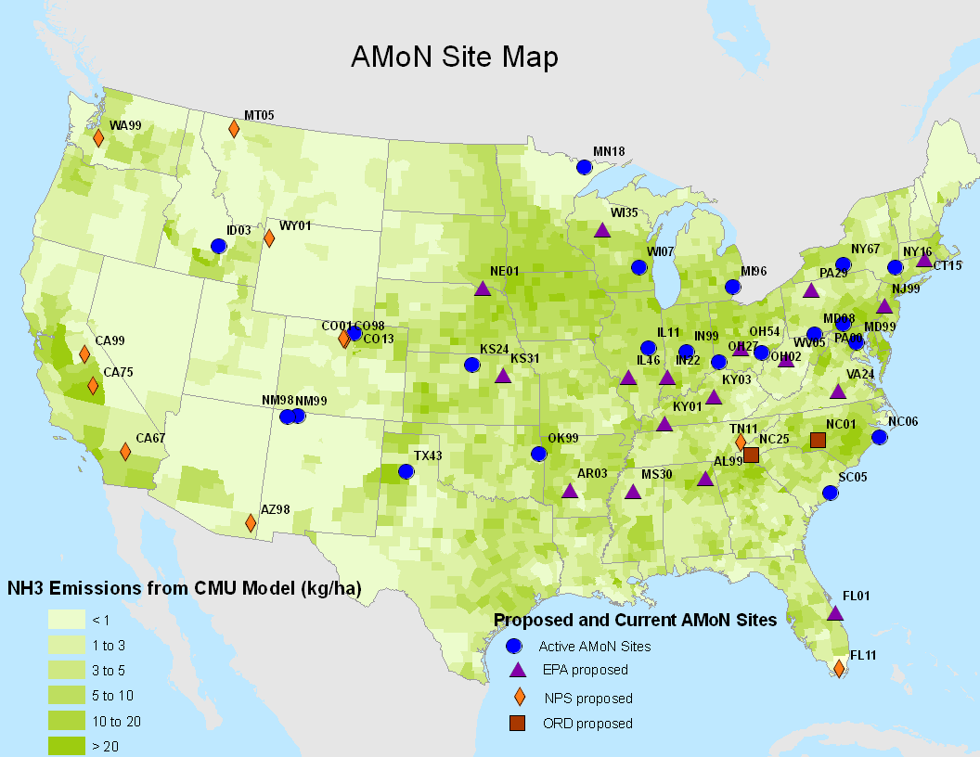
New Site Map (new sites starting ~3/1/11)

